Slide 1
IEEEXtreme Practice
Antonio Sanchez
October 22, 2015

Slide 2
Problems taken from: https://www.hackerrank.com/contests/ieeextreme-challenges/challenges https://github.com/pranavkundra/IEEE-Xtreme-8.0/blob/master/Questions
Game of Thrones – I
Magic Square
Sum it Up
Back to Square 1
Longest common subsequence
Palindrome
Kabloom
Play with GCD

Slide 3
Game of Thrones - I
Problem:
Dothraki are planning an attack to usurp King Robert's throne. King Robert learns of this conspiracy from Raven and plans to lock the single door through which the enemy can enter his kingdom.
But, to lock the door he needs a key that is an anagram of a certain palindrome string.
The king has a string composed of lowercase English letters. Help him figure out whether any anagram of the string can be a palindrome or not.
Constraints:
1≤ length of string ≤10^5 , Each character of the string is a lowercase English letter.
Palindromes: abba, abfba, aabaccabaa
Anagrams: abcde, acdeb, debca, acbad, …

Slide 4
Game of Thrones - I
aaabbbb
bbaaabb
cdefghmnopqrstuvw
cdcdcdcdeeeef
ccddeefeeddcc

Slide 5
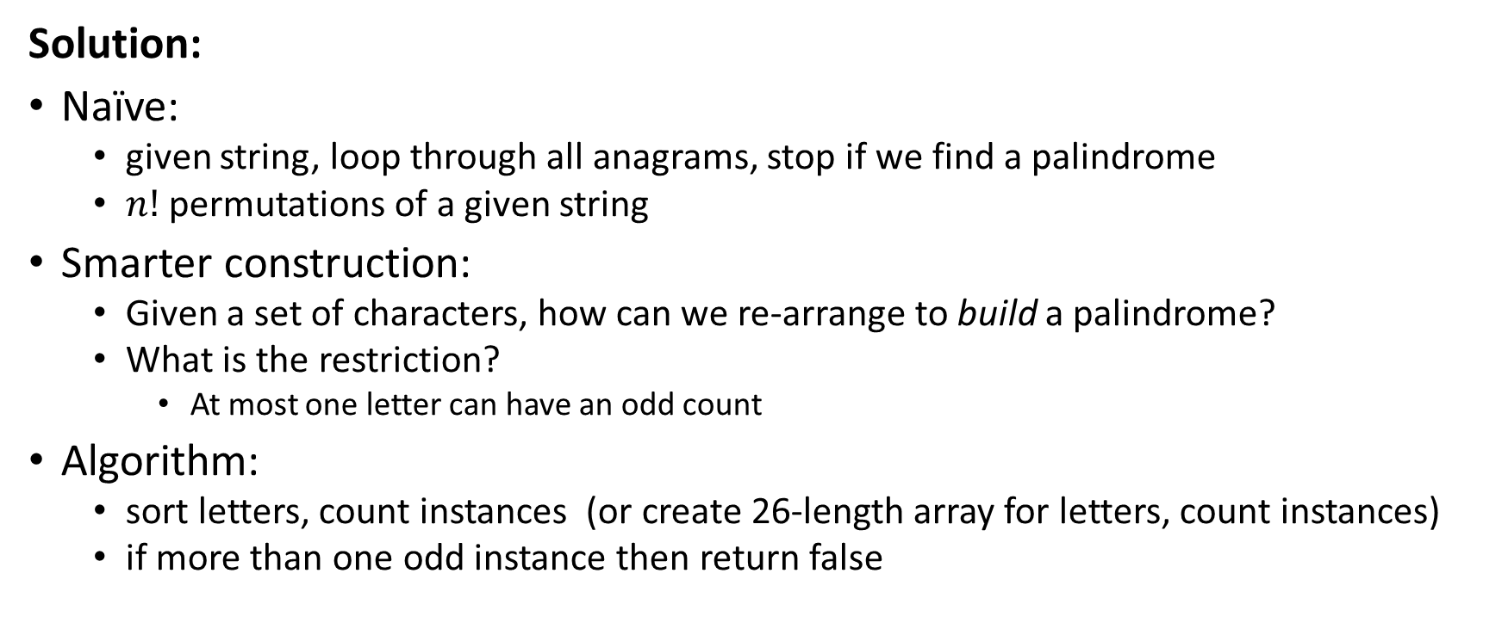
Game of Thrones - I
Solution:
Naïve:
given string, loop through all anagrams, stop if we find a palindrome
$n!$ permutations of a given string
Smarter construction:
Given a set of characters, how can we re-arrange to build a palindrome?
What is the restriction?
At most one letter can have an odd count
Algorithm:
sort letters, count instances (or create 26-length array for letters, count instances)
if more than one odd instance then return false

Slide 6
Magic Square
4 | 9 | 2
3 | 5 | 7
8 | 1 | 6
Problem:
Johnny designed a magic square (square of numbers with the same sum for all rows, columns and diagonals i.e. both the main diagonal - meaning the diagonal that leads from the top-left corner towards bottom-right corner - and the antidiagonal - meaning the diagonal that leads from top-right corner towards bottom-left corner). Write a program to test it.
Task Write a program that will check if the given square is magic (i.e. has the same sum for all rows, columns and diagonals). If a row, column, or the antidiagonal does not sum up to the main diagonal, then output a sorted list of indices for the non-matching lines:
The rows are numbered 1,2,…,N; the columns are numbered -1,-2,…,-N; and the antidiagonal is numbered zero.
N <= 600

Slide 7
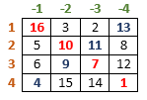
Magic Square
Line | Sum
DIAG | 34
-4 | 34
-3 | 34
-2 | 37
-1 | 31
0 | 37
1 | 34
2 | 34
3 | 34
4 | 34

Slide 8
Magic Square
Solution:
Naïve:
Compute main diagonal sum
Loop through each row, column, and antidiagonal, computing sum
If does not match, add index to list
*Sort output list
NxN to loop through rows/columns (max 600*600)
2N to loop through main and anti-diagonal
N log(N) to sort

Slide 9
Sum it Up
Problem Statement
Minka is very smart kid who recently started learning computer programming. His coach gave him a cyclic array A having N numbers, and he has to perform Q operations on this array.
In each operation the coach would provide him with a number X. After each operation, every element of the cyclic array would be replaced by the sum of itself and the element lying X positions behind it in the cyclic array. All these replacements take place simultaneously.
For example, if the cyclic array was [a, b, c, d], then after the operation with X = 1, the new array would be [a+d, b+a, c+b, d+c].
He needs to output the sum of the elements of the final array modulus 10^9+7. He made a program for it but it's not very efficient. You know he is a beginner, so he wants you to make an efficient program for this task because he doesn't want to disappoint his coach.
N <= 10000, A[i] <= 10^9, Q <= 10^6, X<=N

Slide 10
Sum it Up
A = [ 1, 2, 3, 4, 5], X = [1, 0]
Sum
[ 1, 2, 3, 4, 5]
15
X =1:
[ 1+5, 2+1, 3+2, 4+3, 5+4]
[ 6, 3, 5, 7, 9]
30
X =0:
[ 6+6, 3+3, 5+5, 7+7, 9+9]
[ 12, 6, 10, 14, 18]
60

Slide 11
Sum it Up
// multiplication A*2^Q mod 10^9+7
for (int i=0; i<Q; i++) {
A = (A << 1) % MODULUS;
}
Solution:
Naïve:
Store full cyclic array
For each query, shift and add modulo 10^9+7
Add final array entries together modulo 10^9+7
Complexity: Q*N
Smart Solution:
Recognize that cyclic shift doesn’t matter, doubling sum with each query
result = sum(A)*2^Q % (10^9+7) CAREFUL WITH OVERFLOW

Slide 12
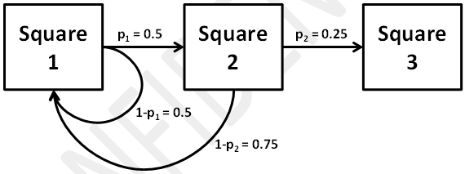
Back to Square 1
Problem:
The game “Back to Square 1” is played on a board that has n squares in a row and n-1 probabilities. Players take turns playing. On their first turn, a player advances to square 1. After the first turn, if a player is on square i , the player advances to square i + 1 with probability p(i) , and returns to square 1 with probability 1-p(i) . The player is finished upon reaching square n . Output the expected number of turns needed to finish the game. N < 1000, Expected number of turns will be < 10^6.

Slide 13
Back to Square 1
Naïve Solution:
Play it out!
Construct the board, start at the first square
Generate a number between [0, 1]. If < p(i), advance, otherwise go back to zero.
Stop when you reach the last square.
Count # turns
Repeat # times, compute the average number of turns
If expected < 1,000,000, probably need 5,000,000 to get an accurate estimate
Worst-case complexity: E^2, E=1,000,000
Smarter Solution:
Compute expected value mathematically

Slide 14
Back to Square 1
Let Ei be the expected number of turns to win from Square[i]
returned to zero, took 1 turn
E₀ = (E₁ + 1)*p₀ + (E₀ + 1)*(1-p₀)
E₀ = E₁ + 1/p₀
successfully advanced, took 1 turn
E₁ = (E₂ + 1)*p₁ + (E₀ + 1)*(1-p₁)
E₀ = E₂ + (1 + p₀)/(p₀*p₁)
E₂ = (E₃ + 1)*p₂ + (E₀ + 1)*(1-p₂)
E₀ = E₃ + (1 + p₀ + p₀*p₁)/(p₀*p₁*p₂)

Slide 15
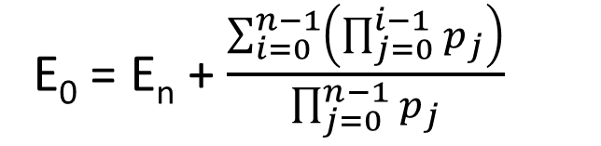
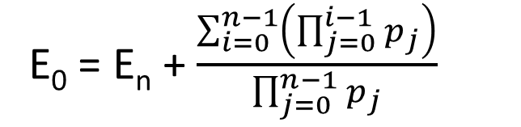
Back to Square 1
E₀ = E_{n} + $\frac{\sum_{i=0}^{n−1}{\left(\prod_{j=0}^{i−1}{p_{j}}\right)}}{\prod_{j=0}^{n−1}{p_{j}}}$
E₀ = E_{n} + $\frac{\sum_{i=0}^{n−1}{\left(\prod_{j=0}^{i−1}{p_{j}}\right)}}{\prod_{j=0}^{n−1}{p_{j}}}$
To get to E₀ to start, takes 1 turn. If we are on the final square, E_{n}, we have won.
E_{n} = 0, Expected # turns = 1 + E₀

Slide 16
Dynamic Programming
Longest common subsequence

Slide 17
Longest Common Subsequence
Given two sequences:
“abcdefghijklmnopz”, “bdfhjlnprtvxz”
Find the longest subsequence (ordered sub-collection of letters) that is common to both.
e.g. “bfjn”, “bdjp”, “bdfhjlnpz” are all common subsequences, the latter being the longest
Naïve Solution:
Generate all possible subsequences of both
Compare all possible pairs
(2^N, 2^M)
N,M= 20, # comparison > 10^12
2^N *2^M

Slide 18
Longest Common Subsequence
X = “abcdefghijklmnopz”,
Y = “bdfhjlnprtvxz”
Smarter approach:
Start with a smaller problem, build up
Let X_{n} be the prefix of X that ends at character n
X₀ = “”, X₁ = “a”, X₂ = “ab”, X₃ = “abc”, etc…
Let L(X_{n}, Y_{m}) be the longest common subsequence of X_{n} and Y_{m}
Consider only the last character of a particular pair of prefixes, (X_{n}, Y_{m})
There are 3 options:
The last character of both sequences is part of the subsequence, xn = ym
The last character of Xn is not part of the subsequence
The last character of Yn is not part of the subsequence
If the characters match, then it will be part of the longest common subsequence
L(X_{n}, Y_{m}) = L(X_{n-1}, Y_{m-1}) + x_{n}
If the characters do not match, take the longest of the other two options:
L(X_{n}, Y_{m}) = max( L(X_{n-1}, Y_{m}), L(X_{n}, Y_{m-1}) )

Slide 19
Longest Common Subsequence
We are looking to solve a mapping of two variables:
L(X_{n}, Y_{m})
This can be expressed entirely as a function of itself, looking at a smaller n or m:
L(X_{n}, Y_{m}) = L(X_{n-1}, Y_{m-1}) + x_{n}, if x_{n} = x_{m} = longer of ( L(X_{n-1}, Y_{m}), L(X_{n}, Y_{m-1}) ), otherwise
Algorithm:
Build a table of size (n+1) x (m+1), start at L(X₀, Y₀) and build up

Slide 20
Longest Common Subsequence
e.g. “OTTERS”, “TOASTERS”
 | “” | “T” | “TO” | “TOA” | “TOAS” | “TOAST” | “TOASTE” | “TOASTER” | “TOASTERS”
“” | “” | “” | “” | “” | “” | “” | “” | “” | “
“O” | “” | “” | O | 0 | O | O | 0 | O | O
“OT” | “”
“OTT” | “”
“OTTE” | “”
“OTTER” | “”
“OTTERS” | “”

Slide 21
Longest Common Subsequence
e.g. “OTTERS”, “TOASTERS”
 | “” | “T” | “TO” | “TOA” | “TOAS” | “TOAST” | “TOASTE” | “TOASTER” | “TOASTERS”
“” | “” | “” | “” | “” | “” | “” | “” | “” | “
“O” | “” | “” | O | 0 | O | O | 0 | O | O
“OT” | “” | T | T | {O, T} | {O, T} | OT | OT | OT | OT
“OTT” | “”
“OTTE” | “”
“OTTER” | “”
“OTTERS” | “”

Slide 22
Longest Common Subsequence
e.g. “OTTERS”, “TOASTERS”
 | “” | “T” | “TO” | “TOA” | “TOAS” | “TOAST” | “TOASTE” | “TOASTER” | “TOASTERS”
“” | “” | “” | “” | “” | “” | “” | “” | “” | “
“O” | “” | “” | O | O | O | O | 0 | O | O
“OT” | “” | T | T | {O, T} | {O, T} | OT | OT | OT | OT
“OTT” | “” | T | T | {O, T} | {O, T} | {OT, TT} | {OT, TT} | {OT, TT} | {OT, TT}
“OTTE” | “” | T | T | {O, T} | {O, T} | {OT, TT} | {OTE, TTE} | {OTE, TTE} | {OTE, TTE}
“OTTER” | “” | T | T | {O, T} | {O, T} | {OT, TT} | {OTE, TTE} | {OTER, TTER} | {OTER, TTER}
“OTTERS” | “” | T | T | {O, T} | {O, T} | {OT, TT} | {OTE, TTE} | {OTER, TTER} | {OTERS, TTERS}

Slide 23
Longest Common Subsequence
Optimizations:
If you don’t actually need the longest sequence, you can store just the length
If you do need a sequence:
Instead of storing the sequence in each block, just store the direction you came from
Reconstruct the sequence by back-tracking from L(M, N), if came from diagonal then you add the last letter corresponding to that row/column
Complexity:
M*N (instead of 2^M*2^N)

Slide 24
“Moderate” Problems
Dynamic Programming XTreme

Slide 25
Palindrome
Problem:
Consider the latin alphabet, ‘a’ to ‘z’. A “word” consists of an ordered sequence of characters of arbitrary length. Given a word w, call an extracted word v a word obtained by deleting some characters in w. For example, “abcd” is an extracted word from “sbanrpsobtcerudoo”.
A palindrome is a word that is symmetric: it can be read indifferently from left to right or right to left.
Given a word “w”, find the length of the longest extracted palindrome from w. If w is a palindrome, then the answer should be the length of w.
The length of the input word will not exceed 2000 characters.

Slide 26
Palindrome
Naïve Solution:
Generate all possible extracted words
For each, test if it is a palindrome
Complexity: 2^N extracted words, N to compare if palindrome → N*2^N
Smart Solution:
Treat like a Longest common subsequence problem:
Looking for LCS between a word and its reverse
Caveat: we cannot repeat the exact same letter (i.e. in the same position)

Slide 27
Palindrome
e.g. “BANALITY”, “YTILANAB”
 | “” | Y | T | I | L | A | N | A | B
“” | 0 | 0 | 0 | 0 | 0 | 0 | 0 | 0 | 0
B | 0
A | 0
N | 0
A | 0
L | 0
I | 0
T | 0
Y | 0

Slide 28
Palindrome
e.g. “BANALITY”, “YTILANAB”
 | “” | Y | T | I | L | A | N | A | B
“” | 0 | 0 | 0 | 0 | 0 | 0 | 0 | 0 | 0
B | 0 | 0 | 0 | 0 | 0 | 0 | 0 | 0
A | 0 | 0 | 0 | 0 | 0 | 1 | 1
N | 0 | 0 | 0 | 0 | 0 | 1
A | 0 | 0 | 0 | 0 | 0
L | 0 | 0 | 0 | 0
I | 0 | 0 | 0
T | 0 | 0
Y | 0
Find the maximum length along the diagonal
We only count one half of the palindrome
If ____________, we can add a letter to the middle of the palindrome

Slide 29
Palindrome
e.g. “ABBLAH”, “HALBBA”
 | “” | H | A | L | B | B | A
“” | 0 | 0 | 0 | 0 | 0 | 0 | 0
A | 0 | 0 | 1 | 1 | 1 | 1
B | 0 | 0 | 1 | 1 | 2
B | 0 | 0 | 1 | 1
L | 0 | 0 | 1
A | 0 | 0
H | 0
Find the maximum length along the diagonal
We only count one half of the palindrome
Xn != Ym
If ____________, we can add a letter to the middle of the palindrome

Slide 30
Kabloom
Problem:
The card game Kabloom is played with multiple decks of playing cards. Players are dealt 2n cards, face up and arranged in two rows of n cards. The players must discard some of the cards, so that the cards that remain in the first row match the rank of the cards that remain in the second row.
The cards match only in rank (e.g. an Ace of Hearts matches any other Ace regardless of suit), but they must appear in the same order in each row. The players are not able to rearrange the order in which the cards appear. Note also that a Joker can match any card including another Joker .
The goal is to maximize the sum of the point value of the cards that remain. Aces are worth 20 points, face cards are worth 15 points, and the numbered cards are worth the number on the card (e.g. the Seven of Clubs is worth 7 points). The value of a Joker is equal to the card with which it is matched, e.g. a Joker matched with an Ace is worth 20 points, a Joker matched with a face card is worth 15 points, etc. If two Jokers are matched with each other, they are worth 50 points each.
Given: n < 1000

Slide 31
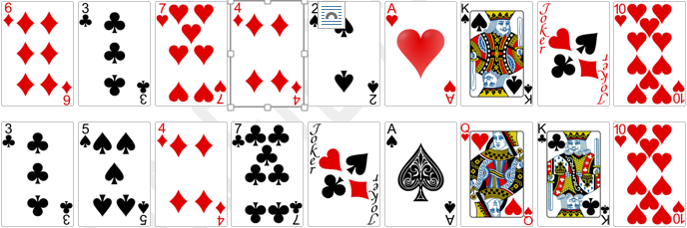
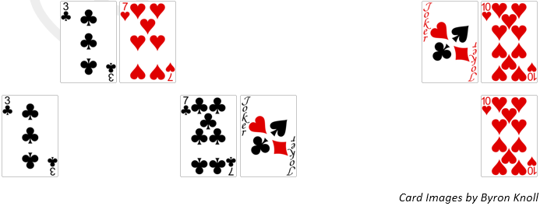
Kabloom
Score: 2*(3 + 7 + 50 + 10) = 140

Slide 32
Kabloom
Solution:
Looks like another Longest Common Subsequence!!
Caveats:
the joker can match multiple cards
appending another pair to the sequence ASAP doesn’t necessarily increase the score
e.g. {2, 3, 4, 9}, {2, 3, A, Joker}, regular LCS will find {2, 3, 4}, {2, 3, Joker} = 20
Similar to LCS, define Xn, Ym as the “prefix” sets
L(n, m) is the score of Xn, Ym
Given {Xn, Ym}, if the last cards are a match, we can either:
include the match score (both xn, ym) count
ignore xn, and find the score of L(n-1, m)
ignore ym, and find the score of L(n, m-1)
If (xn == ym), is it always true that the best score is:
L(n, m) = L(n-1, m-1) + score(xn, ym)?

Slide 33
Play with GCD
Problem
Minka is very smart kid who recently started learning computer programming. He learned how to calculate the Greatest Common Divisor (GCD) of given numbers. The GCD of k numbers, say [n1,n2,n3… nk], is the largest positive integer that divides all these numbers without any remainder.
Minka has N (1 <= N <= 10^5) balls and there is a number V (1 <= V <= 10^4) written on every ball. Now Minka has to perform Q queries, and in each query he wants to know the number of possible ways he can choose balls out of the N balls, so that GCD of the numbers written on the chosen balls equals to the number X of each query. Since number of ways can be very large, your program should output the number of ways modulus 10^9+7.
Notes:
1) There can be at most 100 distinct numbers written on N balls. 2) By definition, the GCD is only defined for 2 or more numbers. For this problem, however, we will consider that the GCD of a single number may also defined and in such case the GCD of a single number will be equal to the number itself (i.e. the GCD of 2 is 2.).

Slide 34
Play with GCD
balls = {2, 3, 5, 6, 6}, X = {2, 5}
gcd==2: {2}, {2, 6}, {2, 6}, {2, 6, 6}
gcd==5: {5}
Can we simplify?
balls = {2, 3, 5, 6}, counts = {1, 1, 1, 2}
gcd==2: {2}, {2, 6}
How many ways to use at least one “2” ball?
2^1-1
How many ways to use at least one “2” and one “6”?
(2^1-1)*(2^2-1)

Slide 35
Play with GCD
Dynamic programming approach?
Construct a function, L(m, n) to give us something useful
What is m? What is n?
Express L(m, n) in some way such that it depends on previously computed values for either smaller m’s or smaller n’s
For a given query, x, if we find two numbers, (a, b) such that gcd(a, b) == x then the # ways of achieving this is: (# ways of obtaining ‘a’) * (# ways of obtaining ‘b’)

Slide 36
Play with GCD
L(m, n):
# ways of obtaining gcd()==m with the first “n” unique balls
Ranges:
m: 1 → max value of balls, n: 1 → number of unique balls
Can you relate the problem of “n” balls to “n-1” balls?
If we can find gcd(balls[0,…,n-1]) == k, we have at least that many ways (we can choose to use no balls of type n)
If we can find gcd(balls[0,…,n-1]) == k, then we can make new combinations: gcd(k, ball[n]) = r And there are L(k, n-1) * (2^count[n]-1) ways of doing so
We can choose no balls from [0, …, n-1], leaving gcd(ball[n], ball[n]) = ball[n] There are (2^count[n]-1) ways of doing this

Slide 37
Play with GCD
balls = {2, 3, 3, 5, 6, 6, 6}, X = {1, 2, 5}
balls = {2, 3, 5, 6}, counts = {1, 2, 1, 3}
balls
 | 2 | 3 | 5 | 6
0 | 0 | 0 | 0 | 0
1
2
3
4
5
6
GCD

Slide 38
Play with GCD
balls = {2, 3, 3, 5, 6, 6, 6}, X = {1, 2, 5}
balls = {2, 3, 5, 6}, counts = {1, 2, 1, 3}
balls
 | 2 | 3 | 5 | 6
0 | 0 | 0 | 0 | 0
1 | 0
2 | 1
3 | 0
4 | 0
5 | 0
6 | 0
3) gcd(ball[0]) = ball[0], (2^count[0]-1) ways
GCD

Slide 39
Play with GCD
balls = {2, 3, 3, 5, 6, 6, 6}, X = {1, 2, 5}
balls = {2, 3, 5, 6}, counts = {1, 2, 1, 3}
balls
 | 2 | 3 | 5 | 6
0 | 0 | 0 | 0 | 0
1 | 0 | 0
2 | 1 | 1
3 | 0 | 0
4 | 0 | 0
5 | 0 | 0
6 | 0 | 0
1) choose 0 of ball[1]
GCD

Slide 40
Play with GCD
balls = {2, 3, 3, 5, 6, 6, 6}, X = {1, 2, 5}
balls = {2, 3, 5, 6}, counts = {1, 2, 1, 3}
balls
 | 2 | 3 | 5 | 6
0 | 0 | 0 | 0 | 0
1 | 0 | 0 + 3
2 | 1 | 1
3 | 0 | 0
4 | 0 | 0
5 | 0 | 0
6 | 0 | 0
1) choose 0 of ball[1]
2) gcd(2, 3)=1, L(2, 0)*(2^count[1]-1) ways = 1*(2^2-1) = 3
GCD

Slide 41
Play with GCD
balls = {2, 3, 3, 5, 6, 6, 6}, X = {1, 2, 5}
balls = {2, 3, 5, 6}, counts = {1, 2, 1, 3}
balls
 | 2 | 3 | 5 | 6
0 | 0 | 0 | 0 | 0
1 | 0 | 3
2 | 1 | 1
3 | 0 | 0 + 3
4 | 0 | 0
5 | 0 | 0
6 | 0 | 0
1) choose 0 of ball[1]
2) gcd(2, 3)=1, L(2, 0)*(2^count[1]-1) ways = 1*(2^2-1) = 3
3) gcd(ball[1]) = ball[1], (2^count[1]-1) ways
GCD

Slide 42
Play with GCD
balls = {2, 3, 3, 5, 6, 6, 6}, X = {1, 2, 5}
balls = {2, 3, 5, 6}, counts = {1, 2, 1, 3}
balls
 | 2 | 3 | 5 | 6
0 | 0 | 0 | 0 | 0
1 | 0 | 3
2 | 1 | 1
3 | 0 | 3
4 | 0 | 0
5 | 0 | 0
6 | 0 | 0
1) choose 0 of ball[1]
2) gcd(2, 3)=1, L(2, 0)*(2^count[1]-1) ways = 1*(2^2-1) = 3
3) gcd(ball[1]) = ball[1], (2^count[1]-1) ways
GCD

Slide 43
Play with GCD
balls = {2, 3, 3, 5, 6, 6, 6}, X = {1, 2, 5}
balls = {2, 3, 5, 6}, counts = {1, 2, 1, 3}
balls
 | 2 | 3 | 5 | 6
0 | 0 | 0 | 0 | 0
1 | 0 | 3 | 3
2 | 1 | 1 | 1
3 | 0 | 3 | 3
4 | 0 | 0 | 0
5 | 0 | 0 | 0
6 | 0 | 0 | 0
1) choose 0 of ball[2]
GCD

Slide 44
Play with GCD
balls = {2, 3, 3, 5, 6, 6, 6}, X = {1, 2, 5}
balls = {2, 3, 5, 6}, counts = {1, 2, 1, 3}
balls
 | 2 | 3 | 5 | 6
0 | 0 | 0 | 0 | 0
1 | 0 | 3 | 3 +3+1+3
2 | 1 | 1 | 1
3 | 0 | 3 | 3
4 | 0 | 0 | 0
5 | 0 | 0 | 0
6 | 0 | 0 | 0
1) choose 0 of ball[2]
2) gcd(1, 5)=1, L(1, 1)*(2^count[2]-1) ways = 3*(2^1-1) = 3
gcd(2, 5)=1, L(2, 1)*(2^count[2]-1) ways = 1*(2^1-1) = 1
GCD
gcd(3, 5)=1, L(3, 1)*(2^count[2]-1) ways = 3*(2^1-1) = 3

Slide 45
Play with GCD
balls = {2, 3, 3, 5, 6, 6, 6}, X = {1, 2, 5}
balls = {2, 3, 5, 6}, counts = {1, 2, 1, 3}
balls
 | 2 | 3 | 5 | 6
0 | 0 | 0 | 0 | 0
1 | 0 | 3 | 10
2 | 1 | 1 | 1
3 | 0 | 3 | 3
4 | 0 | 0 | 0
5 | 0 | 0 | 0+1
6 | 0 | 0 | 0
1) choose 0 of ball[2]
2) gcd(1, 5)=1, L(1, 1)*(2^count[2]-1) ways = 3*(2^1-1) = 3
gcd(2, 5)=1, L(2, 1)*(2^count[2]-1) ways = 1*(2^1-1) = 1
GCD
gcd(3, 5)=1, L(3, 1)*(2^count[2]-1) ways = 3*(2^1-1) = 3
3) gcd(ball[2]) = ball[2], (2^count[1]-1) ways

Slide 46
Play with GCD
balls = {2, 3, 3, 5, 6, 6, 6}, X = {1, 2, 5}
balls = {2, 3, 5, 6}, counts = {1, 2, 1, 3}
balls
 | 2 | 3 | 5 | 6
0 | 0 | 0 | 0 | 0
1 | 0 | 3 | 10
2 | 1 | 1 | 1
3 | 0 | 3 | 3
4 | 0 | 0 | 0
5 | 0 | 0 | 1
6 | 0 | 0 | 0
1) choose 0 of ball[2]
2) gcd(1, 5)=1, L(1, 1)*(2^count[2]-1) ways = 3*(2^1-1) = 3
gcd(2, 5)=1, L(2, 1)*(2^count[2]-1) ways = 1*(2^1-1) = 1
GCD
gcd(3, 5)=1, L(3, 1)*(2^count[2]-1) ways = 3*(2^1-1) = 3
3) gcd(ball[2]) = ball[2], (2^count[1]-1) ways

Slide 47
Play with GCD
balls = {2, 3, 3, 5, 6, 6, 6}, X = {1, 2, 5}
balls = {2, 3, 5, 6}, counts = {1, 2, 1, 3}
balls
 | 2 | 3 | 5 | 6
0 | 0 | 0 | 0 | 0
1 | 0 | 3 | 10 | 10
2 | 1 | 1 | 1 | 1
3 | 0 | 3 | 3 | 3
4 | 0 | 0 | 0 | 0
5 | 0 | 0 | 1 | 1
6 | 0 | 0 | 0 | 0
1) choose 0 of ball[3]
GCD

Slide 48
Play with GCD
balls = {2, 3, 3, 5, 6, 6, 6}, X = {1, 2, 5}
balls = {2, 3, 5, 6}, counts = {1, 2, 1, 3}
1) choose 0 of ball[3]
balls
 | 2 | 3 | 5 | 6
0 | 0 | 0 | 0 | 0
1 | 0 | 3 | 10 | 10 +70+7
2 | 1 | 1 | 1 | 1+7
3 | 0 | 3 | 3 | 3+21
4 | 0 | 0 | 0 | 0
5 | 0 | 0 | 1 | 1
6 | 0 | 0 | 0 | 0
2) gcd(1, 6)=1, L(1, 2)*(2^count[2]-1) ways = 10*(2^3-1) = 70
gcd(2, 6)=2, L(2, 2)*(2^count[2]-1) ways = 1*(2^3-1) = 7
GCD
gcd(3, 6)=3, L(3, 2)*(2^count[2]-1) ways = 3*(2^3-1) = 21
gcd(5, 6)=1, L(5, 2)*(2^count[2]-1) ways = 1*(2^3-1) = 7

Slide 49
Play with GCD
balls = {2, 3, 3, 5, 6, 6, 6}, X = {1, 2, 5}
balls = {2, 3, 5, 6}, counts = {1, 2, 1, 3}
1) choose 0 of ball[3]
balls
 | 2 | 3 | 5 | 6
0 | 0 | 0 | 0 | 0
1 | 0 | 3 | 10 | 87
2 | 1 | 1 | 1 | 8
3 | 0 | 3 | 3 | 24
4 | 0 | 0 | 0 | 0
5 | 0 | 0 | 1 | 1
6 | 0 | 0 | 0 | 0+7
2) gcd(1, 6)=1, L(1, 2)*(2^count[2]-1) ways = 10*(2^3-1) = 50
gcd(2, 6)=2, L(2, 2)*(2^count[2]-1) ways = 1*(2^3-1) = 5
GCD
gcd(3, 6)=3, L(3, 2)*(2^count[2]-1) ways = 3*(2^3-1) = 15
gcd(5, 6)=1, L(5, 2)*(2^count[2]-1) ways = 1*(2^3-1) = 5
3) gcd(ball[3]) = ball[3], (2^count[1]-1) ways

Slide 50
Play with GCD
balls = {2, 3, 3, 5, 6, 6, 6}, X = {1, 2, 5}
balls = {2, 3, 5, 6}, counts = {1, 2, 1, 3}
1) choose 0 of ball[3]
balls
 | 2 | 3 | 5 | 6
0 | 0 | 0 | 0 | 0
1 | 0 | 3 | 10 | 87
2 | 1 | 1 | 1 | 8
3 | 0 | 3 | 3 | 24
4 | 0 | 0 | 0 | 0
5 | 0 | 0 | 1 | 1
6 | 0 | 0 | 0 | 7
2) gcd(1, 6)=1, L(1, 2)*(2^count[2]-1) ways = 10*(2^3-1) = 50
gcd(2, 6)=2, L(2, 2)*(2^count[2]-1) ways = 1*(2^3-1) = 5
GCD
gcd(3, 6)=3, L(3, 2)*(2^count[2]-1) ways = 3*(2^3-1) = 15
gcd(5, 6)=1, L(5, 2)*(2^count[2]-1) ways = 1*(2^3-1) = 5
3) gcd(ball[3]) = ball[3], (2^count[1]-1) ways

Slide 51
Play with GCD
balls = {2, 3, 3, 5, 6, 6, 6}, X = {1, 2, 5}
balls = {2, 3, 5, 6}, counts = {1, 2, 1, 3}
balls
 | 2 | 3 | 5 | 6
0 | 0 | 0 | 0 | 0
1 | 0 | 3 | 10 | 87
2 | 1 | 1 | 1 | 8
3 | 0 | 3 | 3 | 24
4 | 0 | 0 | 0 | 0
5 | 0 | 0 | 1 | 1
6 | 0 | 0 | 0 | 7
Queries:
L(1, 3) = 87
L(2, 3) = 8
L(5, 3) = 1
GCD

Slide 52
GitHub Solutions (Java):
https://github.com/cantonios/IEEEXtremePractice.git

